Slide 1
Community Disaster Preparation WEBINAR
Preparing your community for disasters and emergencies – Northern and Yorke Region of SA
www.communitydisasterprep.com.au
Dr Kristine Peters

Slide 2
Welcome: Simon Millcock CEO Legatus Group
Purpose of the session
Report back – suggestion from Eudunda workshop
Further consultation input
Not all could attend – large area
Recorded and available for all – not just those who attended

Slide 3
Thanks to funding from …
This project is funded under the Disaster Risk Reduction Grants Program funded by the Australian Government and the South Australian Government and delivered by the Legatus Group (Central Region of Local Government) to address a gap in collaborative disaster management planning by councils and their communities.
Thanks to the reference group who have provided valuable in put through out the process.

Slide 4
What were the workshops about?
To bring communities and councils together to think about how they prepare for a disaster,
To help everyone to understand their role and how to prepare ahead of time so that they are effective in their response and can support their own and their community’s wellbeing, and
To learn more about support and how to access it.

Slide 5
Who came?
10 workshops: Adelaide Plains, Copper Coast, Flinders Ranges (combining Orroroo Carrieton), Goyder, Light (combining Barossa), Northern Areas, Peterborough, Port Pirie (combining Barunga West and Mt Remarkable), Wakefield, Yorke Peninsula
Clare & Gilbert Valley Council declined to be involved, however a community planning workshop was held in Mintaro with good attendance
>100 participants

Slide 6
Key lessons from the workshops
There was wholehearted agreement about the need for community disaster planning
Every agency and council reported difficulties engaging community groups in disaster (and other) planning, and in attracting and retaining volunteers
The toolkit was seen to be a useful resource for both councils and community groups
Community members (not involved in emergency services) were in the minority, so instead of running community planning, the focus shifted to how to engage communities
Participants (including those from emergency services) found the discussion to be worthwhile: “Even though we’re involved in Zone Emergency Management Planning, we don’t get a chance to discuss issues informally at a community level, this has given me a better understanding of what people know and don’t know, and I’ve learned some new things.”

Slide 7
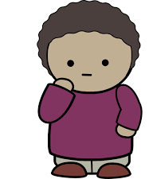
The importance of introductions
I thought I was the only one who felt like that
Your name
Organisation/group
Interests or concerns about your community’s readiness for a disaster
At last, someone is listening to me
Thank goodness I got to say something early, now I’m not so nervous about discussing my concerns

Slide 8
Australian Disaster Resilience Index
Apart from providing information for strategic planning or grant applications, the ADRI graphs got people talking – for example we found communications black spots where even the CFS trucks can’t get radio reception, and we heard about the challenges of engaging new residents and people with holiday homes.
https://adri.bnhcrc.com.au/#!/
Notes:
Ask participants how long they’ve lived here – how well are they connected to newcomers? Who do they go to for information?

Slide 9
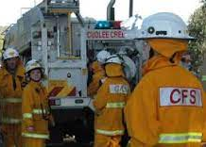
The role of First Responders
CFS presented at every workshop
As well as updates by SES, SAPOL, SAAS
CFS bushfire preparedness programs are fantastic, local and free – yet very few people have a written and practiced bushfire plan.
CFS planning is an excellent intro to broader disaster planning, how do we get more take-up?

Slide 10
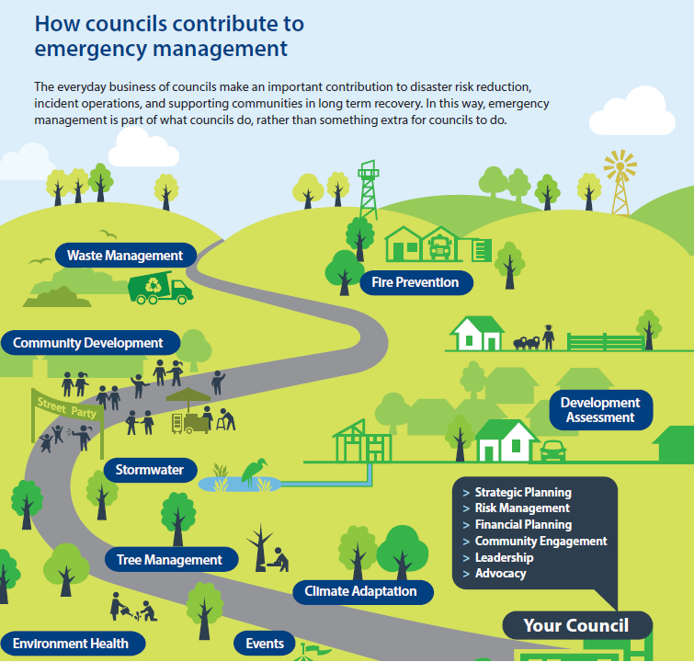
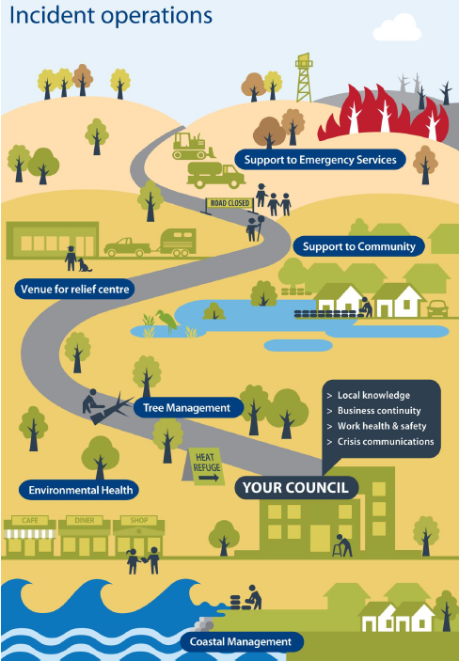
Where does Local Government fit?
Some Elected Members didn’t know about these LGA resources …
If councils don’t know, how can we expect communities to understand?

Slide 11
There are some levers that councils can pull
Making sure their own Incident Operations and Disaster Management Plans are up to date and leverage community resources (a surprising number of councils only have ‘policies’, even more look inward and barely acknowledge the community)
Requiring annual disaster planning as a condition of funding (e.g. for progress associations) and leases (e.g. halls and sporting facilities)
Including weekly planning and preparation reminders in council newsletters (e.g. from CFS’ 26 Weeks to Preparedness)
Quarantining part of their community grants fund for specific disaster preparation activities (e.g. community workshops or hall upgrades)
Providing disaster response and messaging training for Mayors and CEOs early after appointment
Tying event funding to disaster preparation to ‘normalise’ discussion

Slide 12
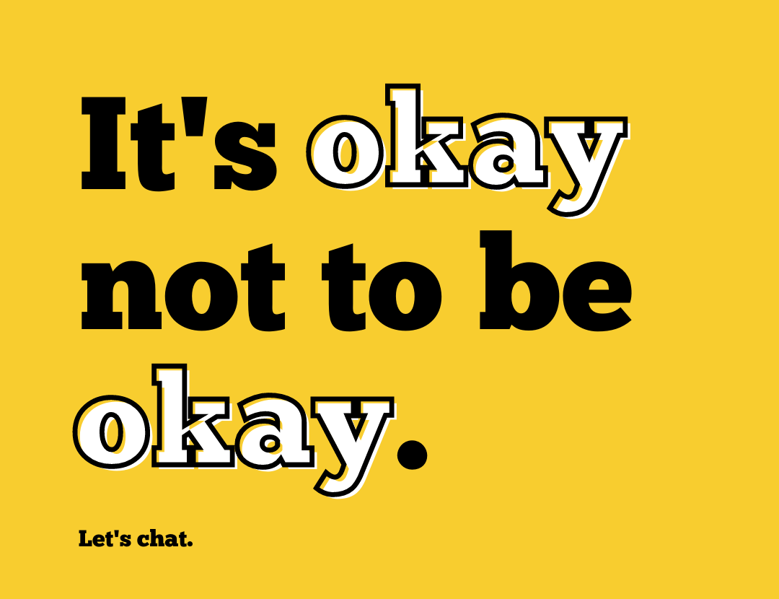
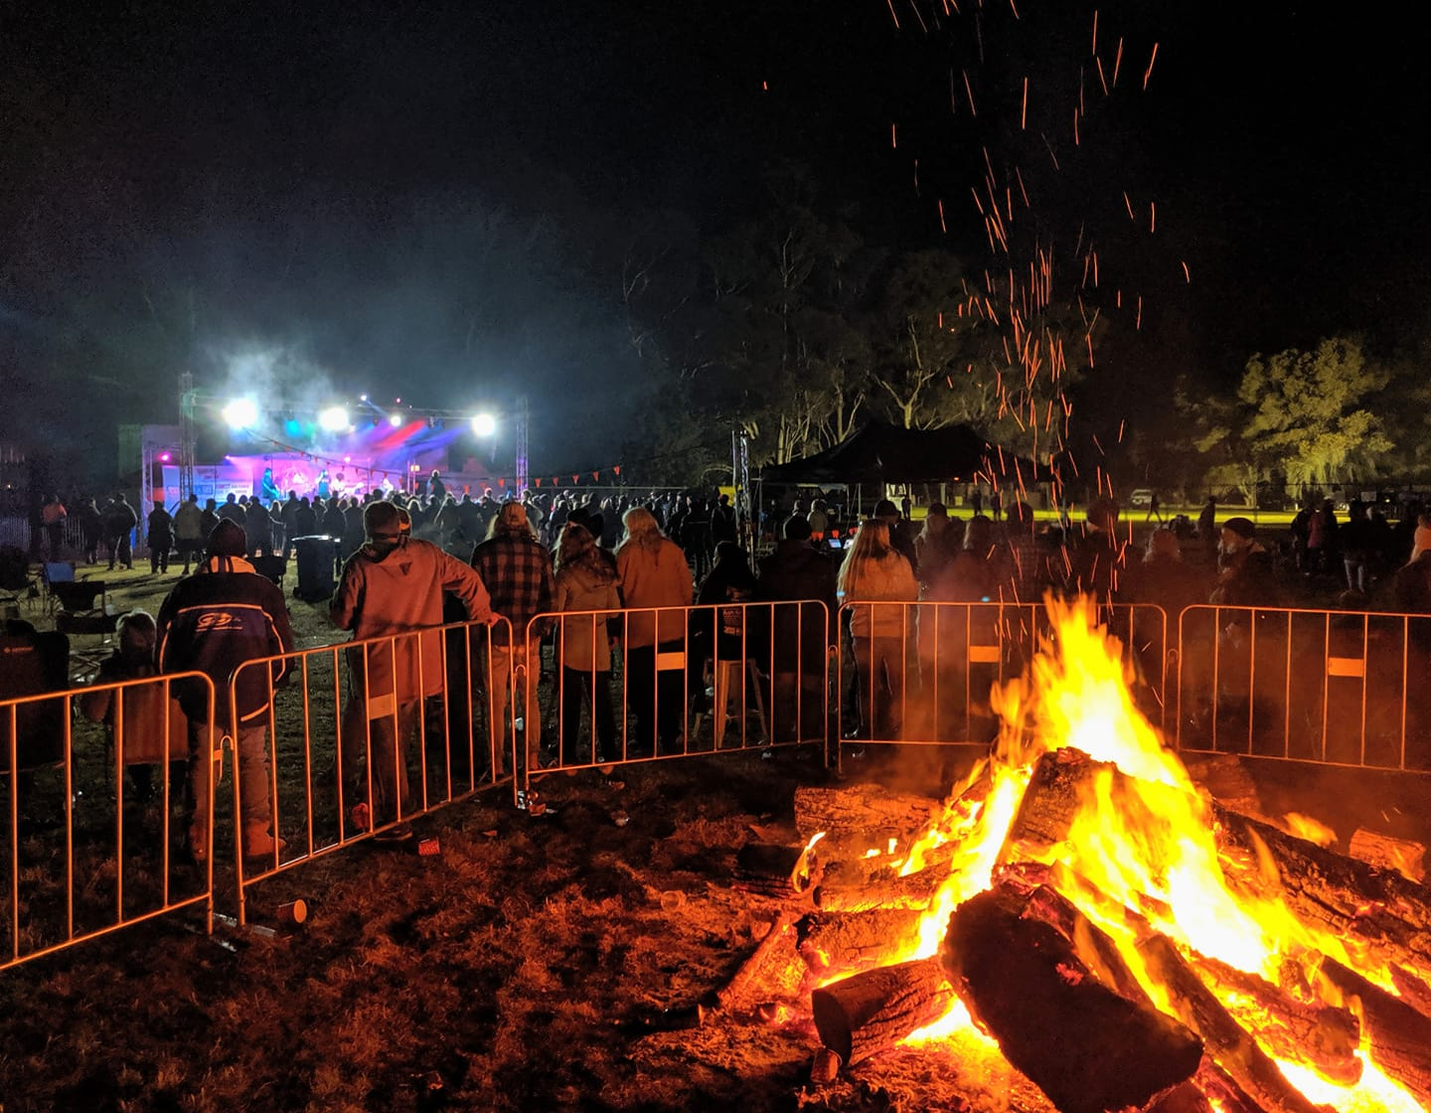
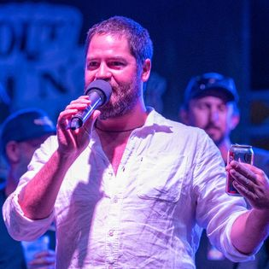
Get the message to the people ‘where they are’ through stories

Slide 13
How are you feeling?
The workshops raised emotions from past disasters, some many years ago
Participants (including first responders) found it valuable to be able to talk about past disasters in a supportive environment – the workshops should allow for unstructured discussion to let these issues surface and be acknowledged
We need to keep reminding people that although mental health programs linked to that disaster might have ended, there are a lot of on-going (and free) supports available
Communities that are prepared (e.g. Mental Health First Aid or Accidental Counsellor) do better during and after an event

Slide 14
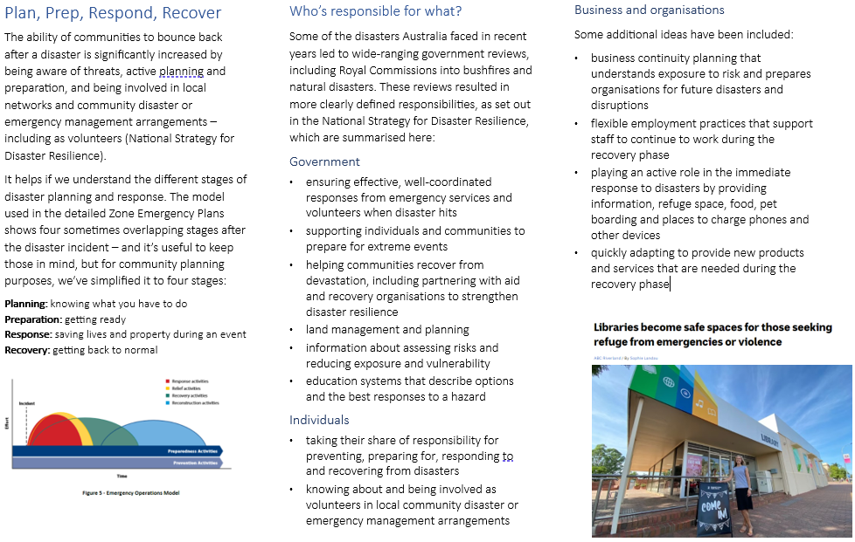
Community Disaster Preparation Toolkit
There was positive feedback and constructive suggestions about the handbook and toolkit resources
The Toolkit manual plus heaps of resources will be on the communitydisasterprep.com.au website at the end of this project
Notes:
Covers:
Plan, prepare, respond, recover stages
Government roles
Community is essential
We’re OK, we’ve done this before
Home, neighbours, community
Council working with community
Maslow and Pareto
Community Action Plan
The process from start to finish
Reference and resources

Slide 15
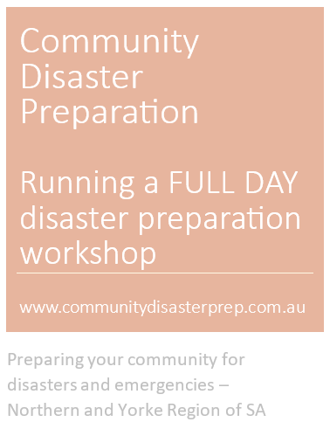
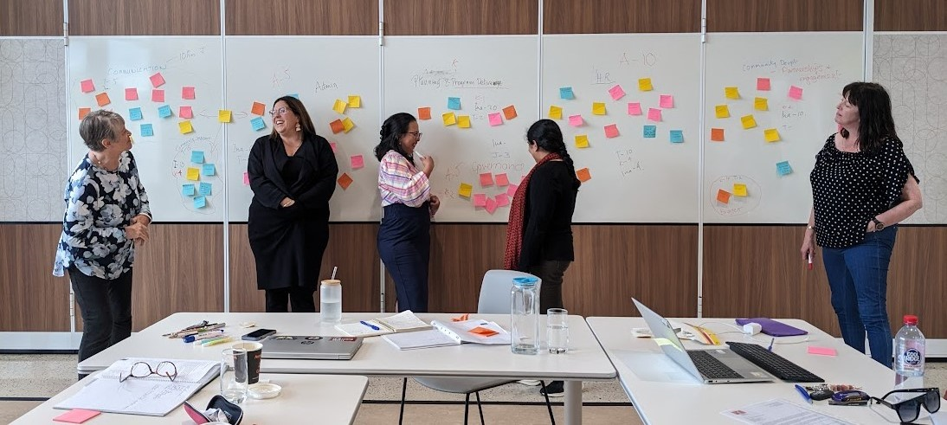
We tested the community disaster planning workshop with the Mintaro Progress Association
Hang on, I’m not from Mintaro!
No, but it’s a good photo.

Slide 16
The website is morphing ….
www.communitydisasterprep.com.au
From workshop booking page to …
Holding page, to …
Handbook and Toolkit (from December 2023)

Slide 17
Famous last words…
Gaps?
Suggestions?
Blinding flashes of the obvious?

Slide 18
Where to from here - Simon
Meeting with Local Govt Association and other Regional LGAs 30/10
Progressing the case study of Mintaro
Reference Group meeting
Report to the Board 24/11
Finalise and launch
But don’t wait for us – Get started now

